Slide 1

AI ENHANCED SUPPLY CHAIN MANAGEMENT FOR TEA LEAVES IN AGRICULTURE
24-25J-303

Slide 2
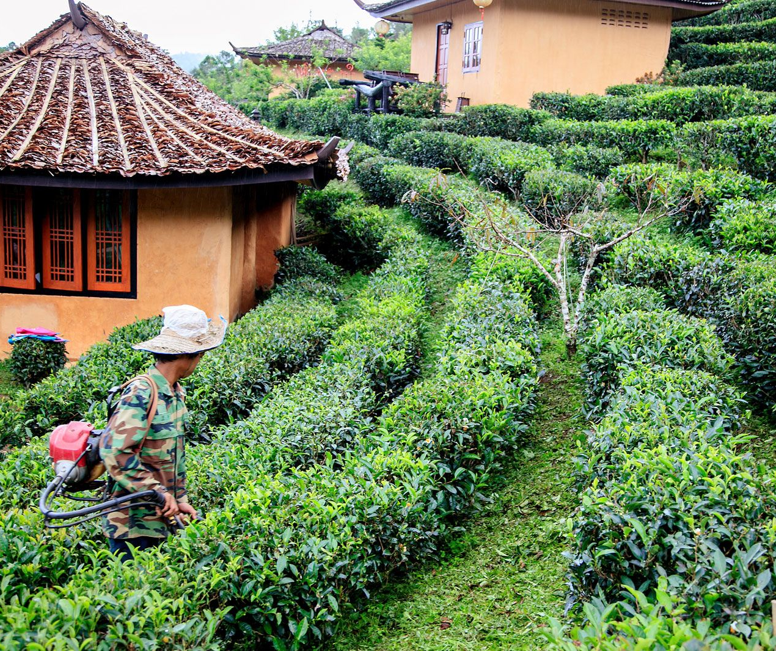
Introduction
Efficiently manages the journey of tea leaves from plantations to consumers.
Involves key processes like sourcing, inventory management, labor planning, and logistics.
Aims to reduce costs and minimize waste while maintaining quality.
Ensures a steady supply of tea through streamlined operations.

Slide 3

Research Question
How to accurately predict tea demand and raw material needs based on weather data and other predictive indicators.
How to optimize inventory levels, reducing wastage and ensuring a steady supply of raw materials.
How to manage and mitigate risks associated with labor shortages and ensure adequate staffing levels.
How to enhance logistics operations by predicting traffic patterns and optimizing delivery schedules.

Slide 4

Objectives
Implementing a supply chain management system with AI automated technologies that we can aim to optimize operations, reduce costs, and improve overall service delivery in our tea production and distribution processes.

Slide 5
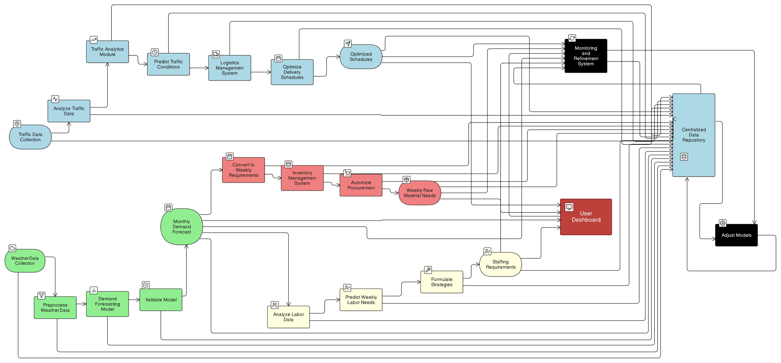
Overall System Diagram

Slide 6

IT21155970 | Madushan S.M.P.K.G.S
Specialization : Information Technology
IT21155970 | Madushan S.M.P.K.G.S | 24-25J-303

Slide 7
Introduction & Background
Introduction:
Tea is the most consumed beverages, with demand affected by various factors such as weather , market trends, and consumer preferences.
Accurate demand forecasting is crucial for optimizing supply chain operations, reducing waste, and ensuring market stability.
Background:
Traditional forecasting methods rely on historical sales data, but AI-driven models enhance accuracy by incorporating weather and market trends.
The tea industry faces challenges like inaccurate demand, seasonal variations, and supply chain disruptions, making advanced forecasting techniques essential.
IT21155970 | Madushan S.M.P.K.G.S | 24-25J-303

Slide 8

Research Question
How can demand forecasting system address the challenges facing the tea supply chain?
Overreliance on historical data
Inaccurate demand forecasts
Increased wastage
IT21155970 | Madushan S.M.P.K.G.S | 24-25J-303

Slide 9

Research Gap
Existing models lack advanced techniques like LSTM for accurate predictions.
Current approaches rely on historical data without leveraging machine learning advancements.
Most research focuses on general agriculture, failing to address the unique dynamics of tea demand.
Existing systems do not effectively handle weather and market variations in the tea industry.
The existing method does not focus on forecasting demand regionally, resulting in inaccurate results.
IT21155970 | Madushan S.M.P.K.G.S | 24-25J-303

Slide 10

Specific and Sub Objective
Analyze historical demand data .
Select most appropriate machine learning algorithms for tea demand forecasting.
Integrate weather, market trends into the forecasting model.
Develop a demand forecasting model using machine learning techniques.
Implement the model into a user-friendly web application for stakeholders.
Validate the system through testing in real-world scenarios for reliability and effectiveness.
IT21155970 | Madushan S.M.P.K.G.S | 24-25J-303

Slide 11
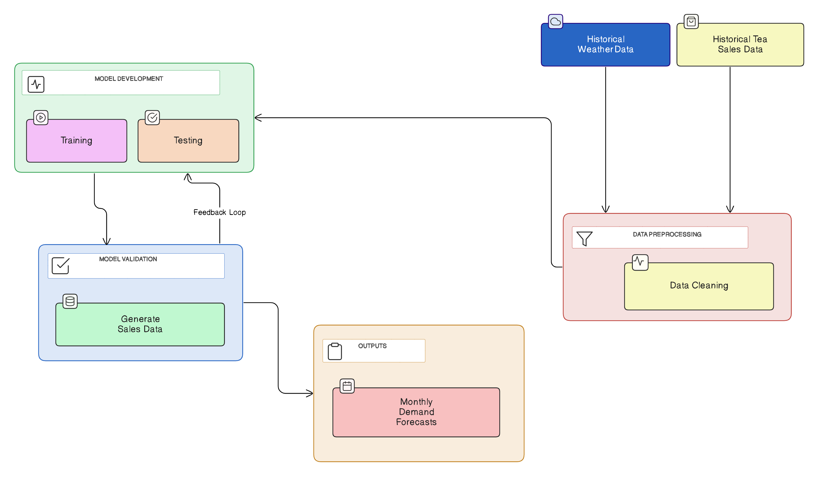
Methodology System Diagram
IT21155970 | Madushan S.M.P.K.G.S | 24-25J-303

Slide 12

Methodology
Data Collection and Analysis
Collect historical sales and weather data
Model Development
Implement LSTM (Long Short-Term Memory) to predict monthly forecasts.
System Design
Create a user-friendly web interface for interaction.
Testing and Validation
Performing unit testing, integration testing, system testing and user acceptance testing.
Deployment
Deploying the demand forecasting system on scalable cloud platforms to ensure real-time forecasting and system scalability.
IT21155970 | Madushan S.M.P.K.G.S | 24-25J-303

Slide 13
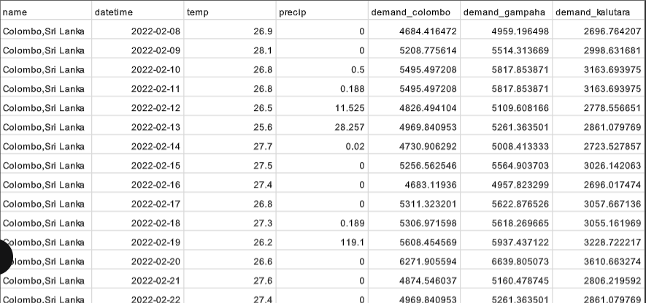
Methodology Evidence of Completion
Data Collection
IT21155970 | Madushan S.M.P.K.G.S | 24-25J-303

Slide 14
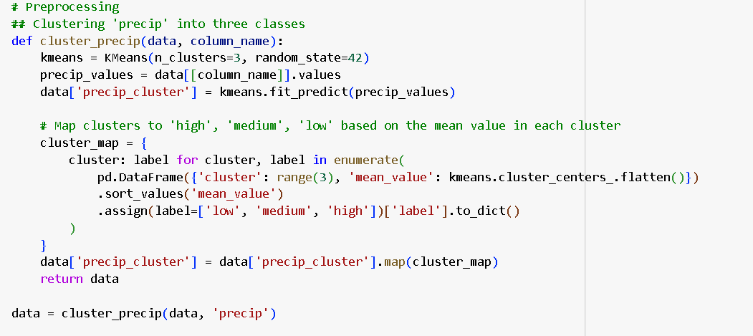
Methodology Evidence of Completion
Data preprocessing
IT21155970 | Madushan S.M.P.K.G.S | 24-25J-303

Slide 15
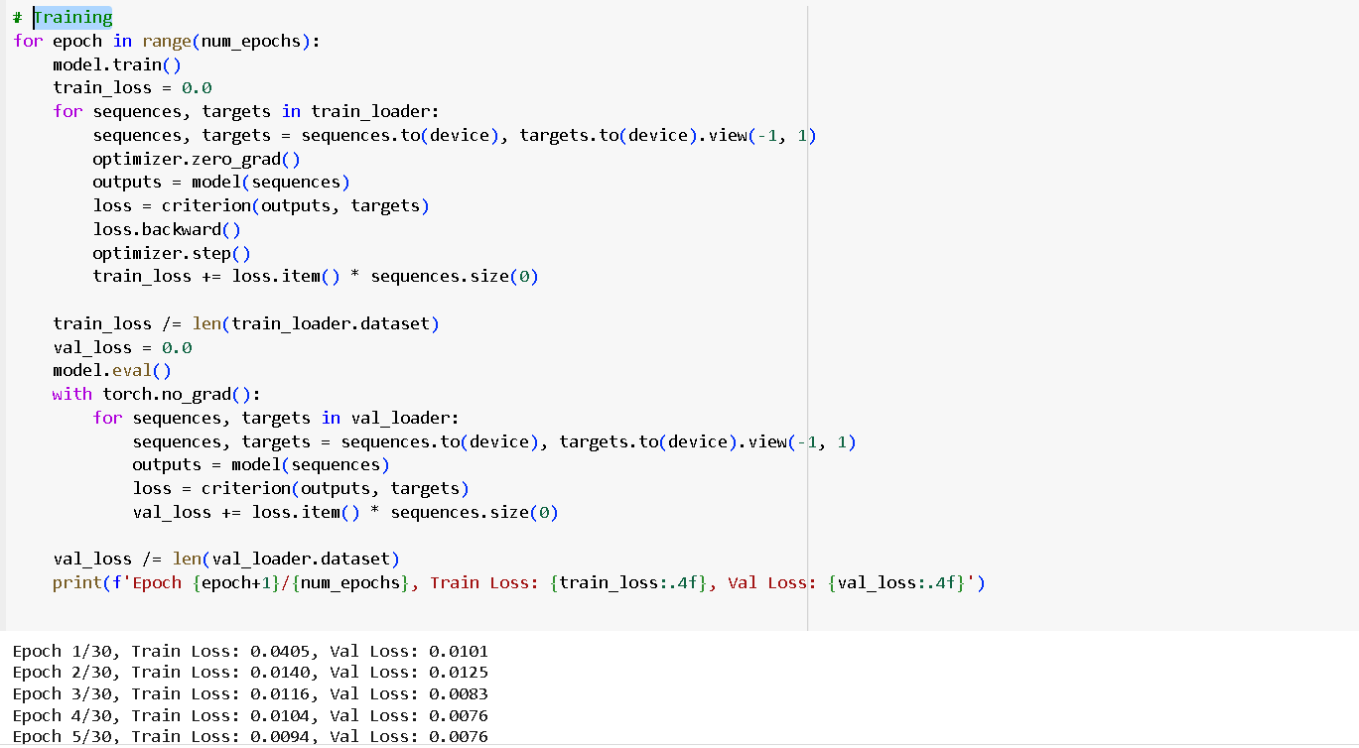
Methodology Evidence of Completion
Training models using preprocessed datasets
IT21155970 | Madushan S.M.P.K.G.S | 24-25J-303

Slide 16
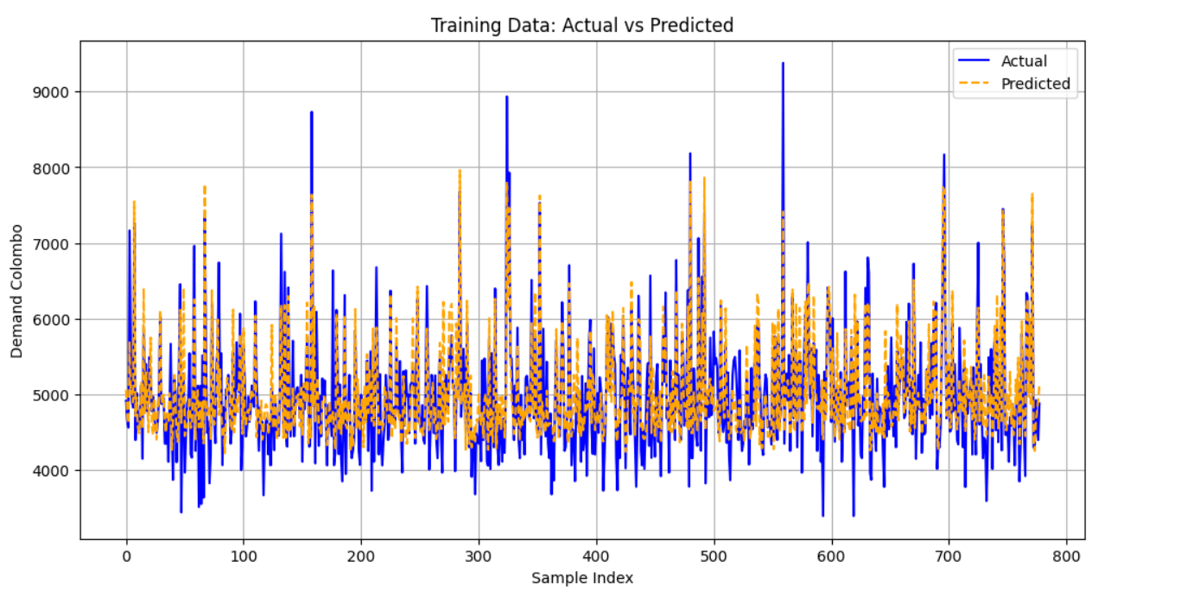
Methodology Evidence of Completion
Actual vs Predicted Result Colombo
IT21155970 | Madushan S.M.P.K.G.S | 24-25J-303

Slide 17
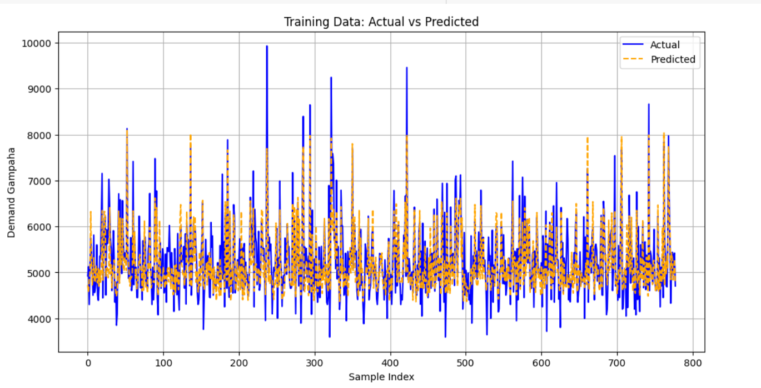
Methodology Evidence of Completion
Actual vs Predicted Result Gampaha
IT21155970 | Madushan S.M.P.K.G.S | 24-25J-303

Slide 18
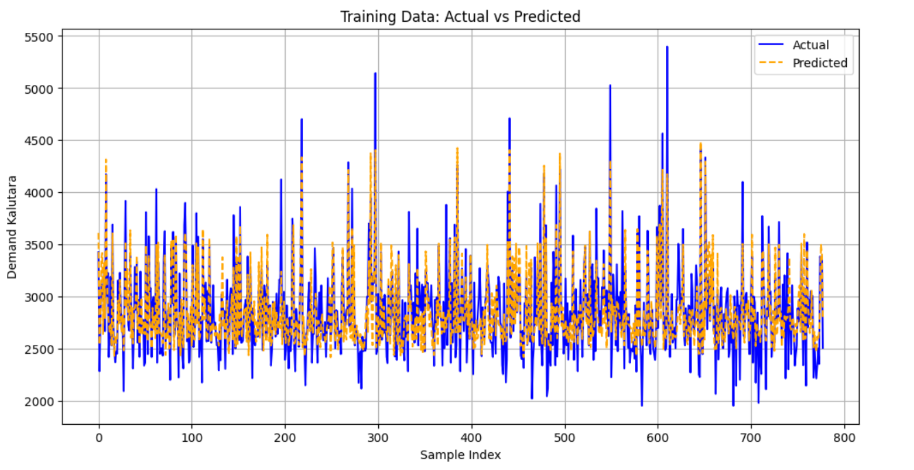
Methodology Evidence of Completion
Actual vs Predicted Result Kaluthara
IT21155970 | Madushan S.M.P.K.G.S | 24-25J-303

Slide 19
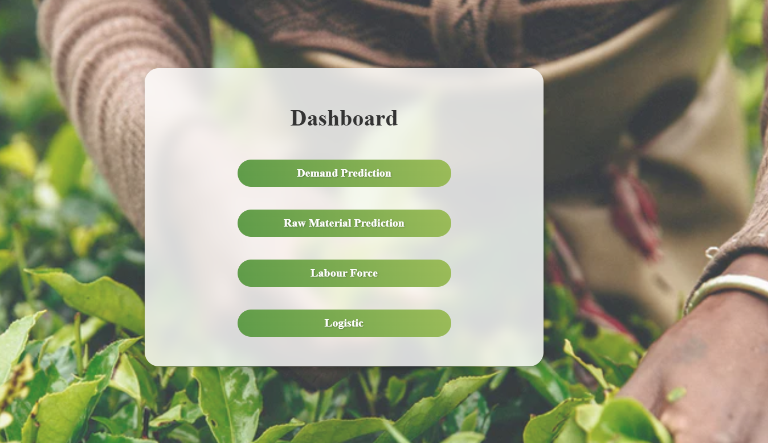
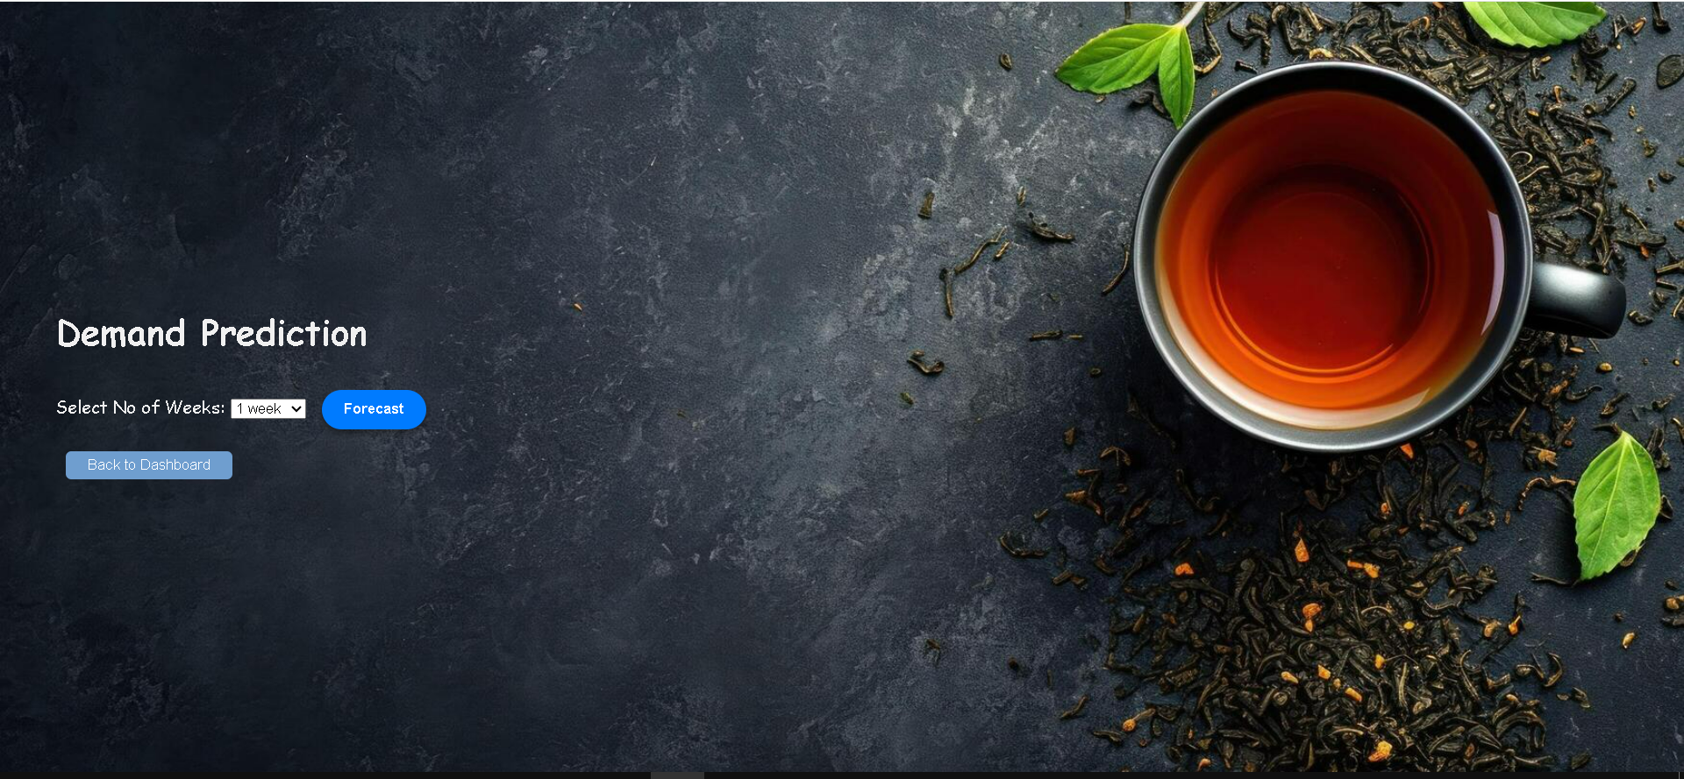
Methodology Evidence of Completion
IT21155970 | Madushan S.M.P.K.G.S | 24-25J-303

Slide 20
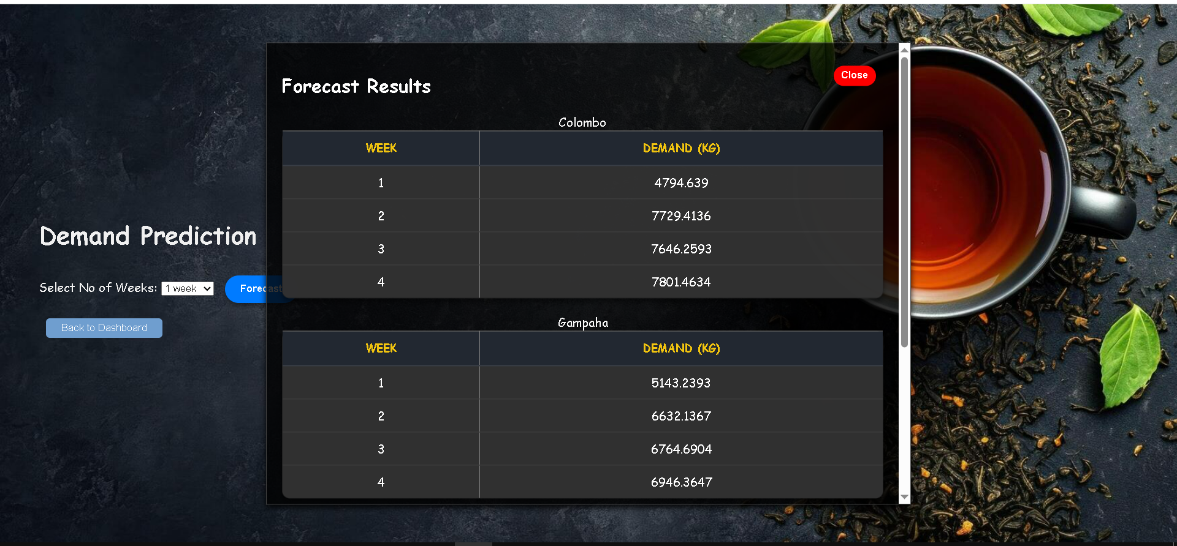
Methodology Evidence of Completion
Demand Forecasting for Next 4 Week
IT21155970 | Madushan S.M.P.K.G.S | 24-25J-303

Slide 21
Used Techniques and Technologies
Technologies
Flask Python
Html
Css
Pandas
Matplotlib
Sklearn
Flask Server
Numpy
Google Colab
mongoDB
Techniques
Data preprocessing
Data Validation
Data Visualization
IT21155970 | Madushan S.M.P.K.G.S | 24-25J-303

Slide 22
Functional, Non-Functional and Requirements
Functional Requirements
Collect and preprocess historical weather and sales data.
Analysis to identify weather impacts on sales.
Build and train machine learning models for demand forecasting.
Validate accuracy with data.
Generate monthly tea demand forecasts.
Non-Functional Requirements
Support multiple data sources and regions.
User-friendly interface with clear visualization.
IT21155970 | Madushan S.M.P.K.G.S | 24-25J-303

Slide 23
Completion of the project
Completion of the Components
Integration data sources, including weather patterns and market trends
Analysis of historical data to identify demand factors.
Completion of the project model training and testing part.
Selection and optimization of machine learning algorithms for forecasting accuracy.
Frontend dashboard design for monitoring and interactive visualization of forecasting outcomes.
Testing and validation using expanded datasets from multiple regions.
IT21155970 | Madushan S.M.P.K.G.S | 24-25J-303

Slide 24
References
[1] Gijo, E. V. (2011). Demand forecasting of tea by seasonal ARIMA model. International Journal of Business Excellence, 4(1), 111-124.
[2] Seyedan, M., & Mafakheri, F. (2020). Predictive big data analytics for supply chain demand forecasting: methods, applications, and research opportunities. Journal of Big Data, 7(1), 53.
[3] Abolghasemi, M., Beh, E., Tarr, G., & Gerlach, R. (2020). Demand forecasting in supply chain: The impact of demand volatility in the presence of promotion. Computers & Industrial Engineering, 142, 106380.
[4] Babai, M. Z., Boylan, J. E., & Rostami-Tabar, B. (2022). Demand forecasting in supply chains: a review of aggregation and hierarchical approaches. International Journal of Production Research, 60(1), 324-348.
IT21155970 | Madushan S.M.P.K.G.S | 24-25J-303

Slide 25

IT211069101 | Gimhani K.M.B.K
Specialization : Information Technology
IT21106910 | Gimhani K.M.B.K | 24-25J-303

Slide 26
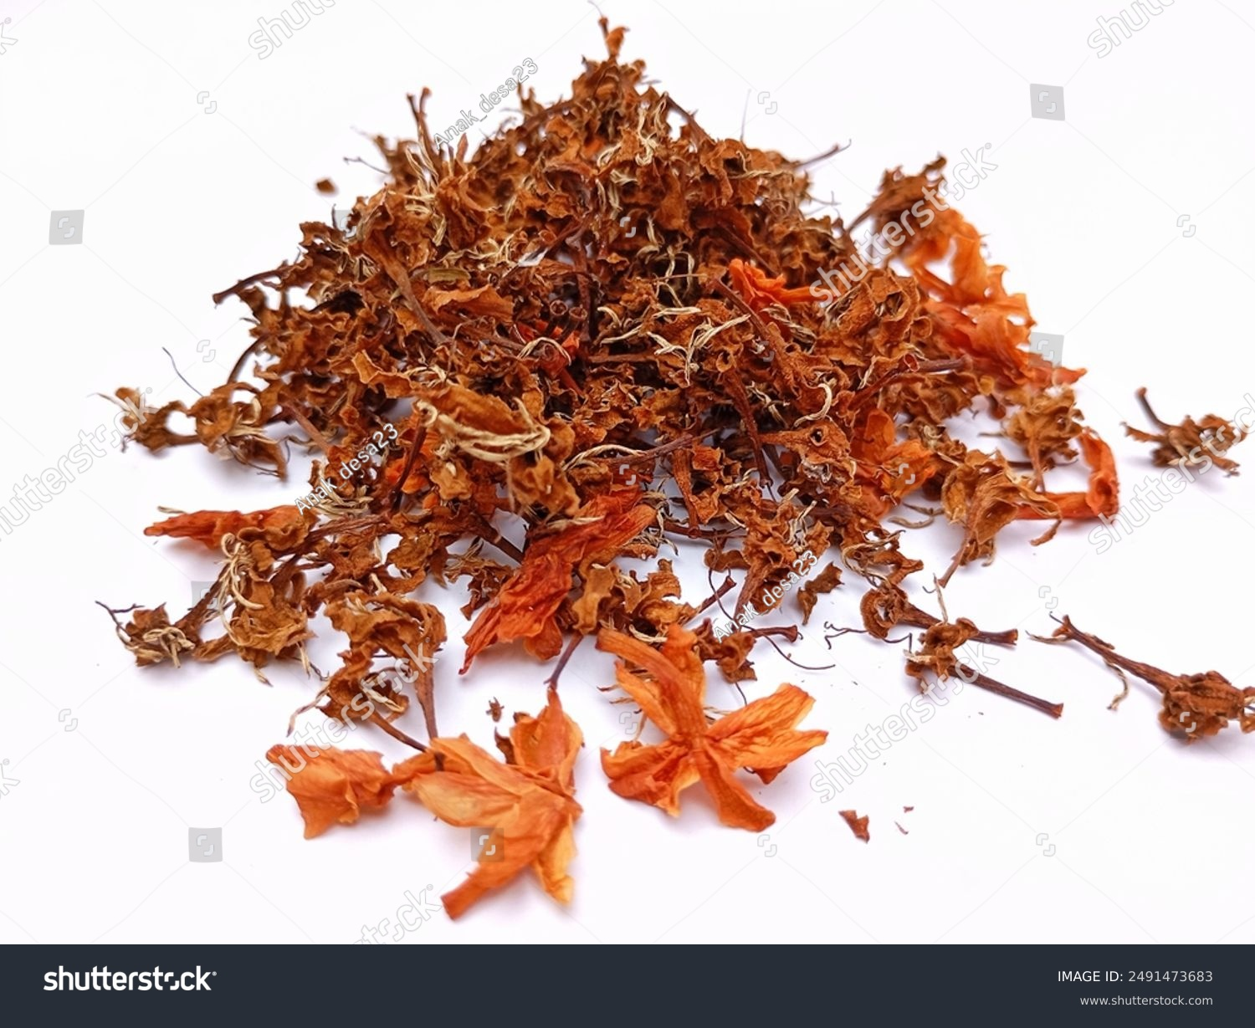
Introduction and Background
Accurately estimating weekly raw material needs is essential for ensuring that procurement aligns with production schedules and market trends.
Traditional methods conventional approaches rely on manual processes and basic forecasting techniques, frequently leading to either excess stock or shortages.
Key challenges include the lack of seamless integration between monthly demand forecasts and weekly inventory planning, which often results in inefficiencies.
With AI and machine learning, businesses can forecast demand more accurately, automate procurement processes, and maintain optimal inventory levels with ease.
IT21106910 | Gimhani K.M.B.K | 24-25J-303

Slide 27
Research Gap
Lack of AI-Driven Inventory Optimization - Develop AI-powered predictive models to optimize stock levels and prevent over/under-stocking.
Inefficient Demand-Supply Forecasting - Use machine learning & data analytics to predict demand fluctuations accurately.
Inefficient Supply Chain Management - Develop AI-based route optimization and inventory management systems to streamline logistics and reduce transportation costs.
IT21106910 | Gimhani K.M.B.K | 24-25J-303

Slide 28
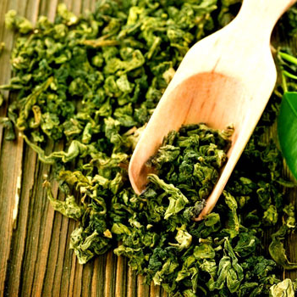
Research Question
How can an AI-enhanced inventory management system address the challenges in managing raw materials for tea production?
Overreliance on static monthly forecasts
Inaccurate raw material planning
Inability to adapt to supply chain fluctuations
Increased wastage of raw materials
IT21106910 | Gimhani K.M.B.K | 24-25J-303

Slide 29
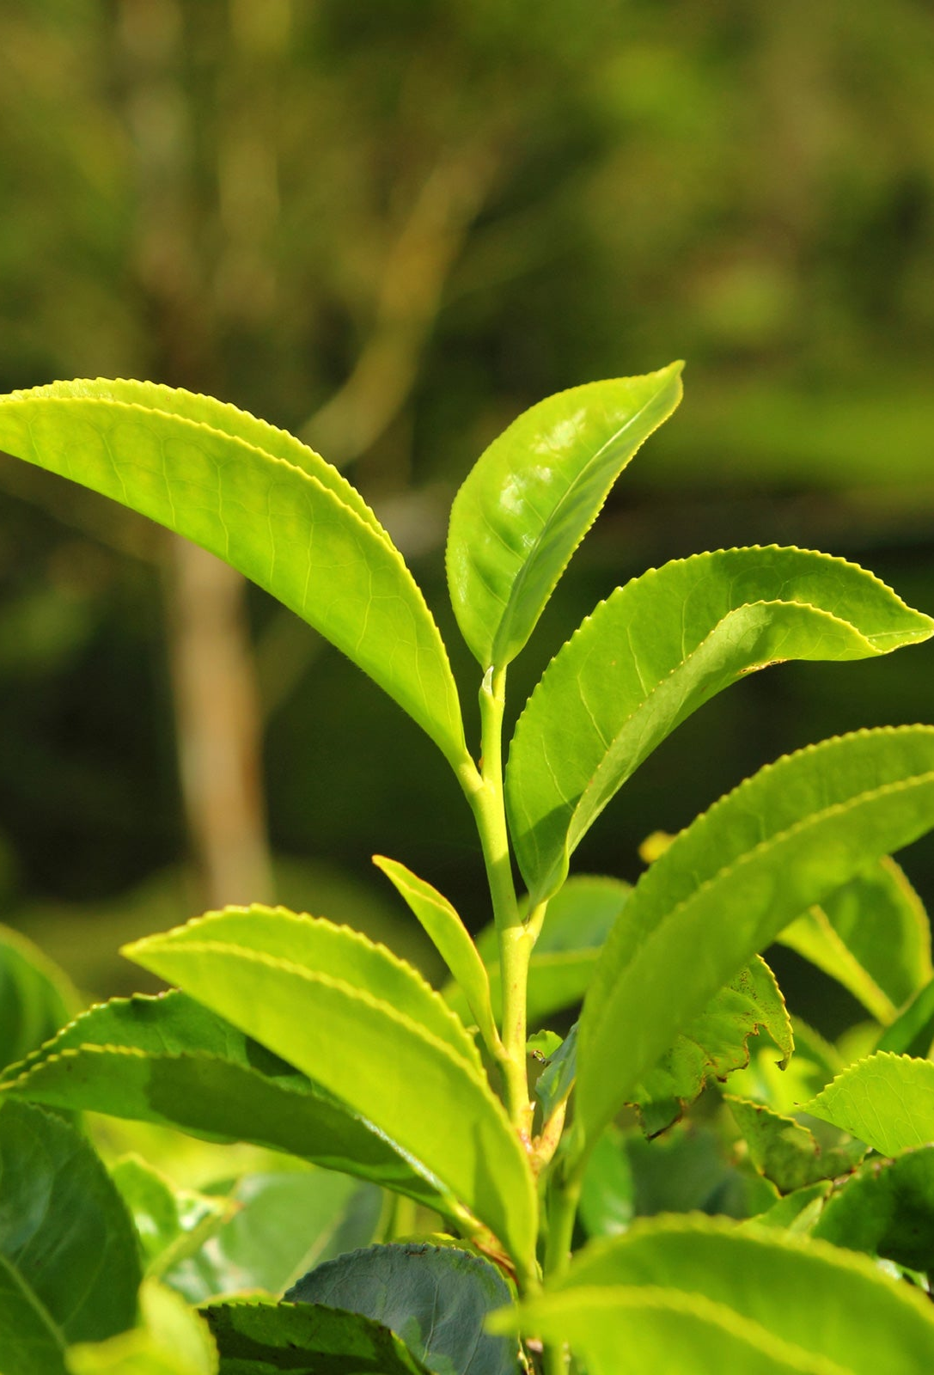
Specific and Sub Objective
Specific Objective
To develop an AI-driven inventory management system that converts monthly demand forecasts into precise weekly raw material predictions, ensuring optimal inventory levels with minimal waste.
Sub Objective
Data Driven weekly conversion
Inventory optimization
Waste reduction and efficiency
IT21106910 | Gimhani K.M.B.K | 24-25J-303

Slide 30
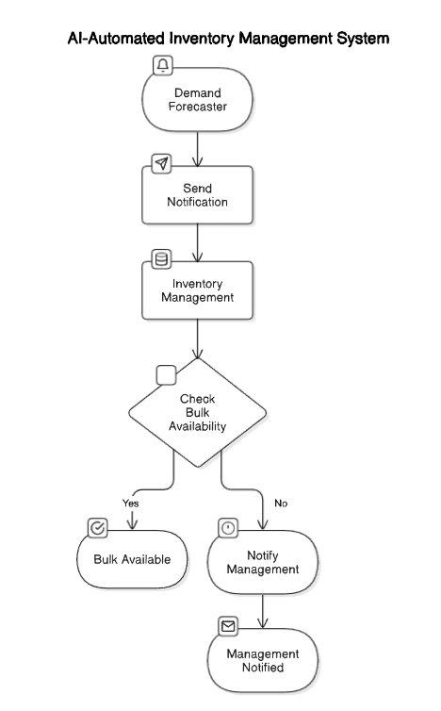
System Diagram
IT21106910 | Gimhani K.M.B.K | 24-25J-303

Slide 31

Methodology
Data Collection and Analysis
Monthly sales forecasts and historical data and integrate data with seasonal patterns and demand trends.
Model Development
Implement LSTM (Long Short-Term Memory) to predict weekly raw material requirements based on monthly forecasts.
System Design
Create an AI-Automated platform with a a user-friendly web interface for interaction.
Testing and Validation
Performing unit testing, integration testing, system testing and user acceptance testing.
Deployment
Deploying the inventory management system on scalable cloud platforms to ensure real-time forecasting and system scalability.
IT21106910 | Gimhani K.M.B.K | 24-25J-303

Slide 32
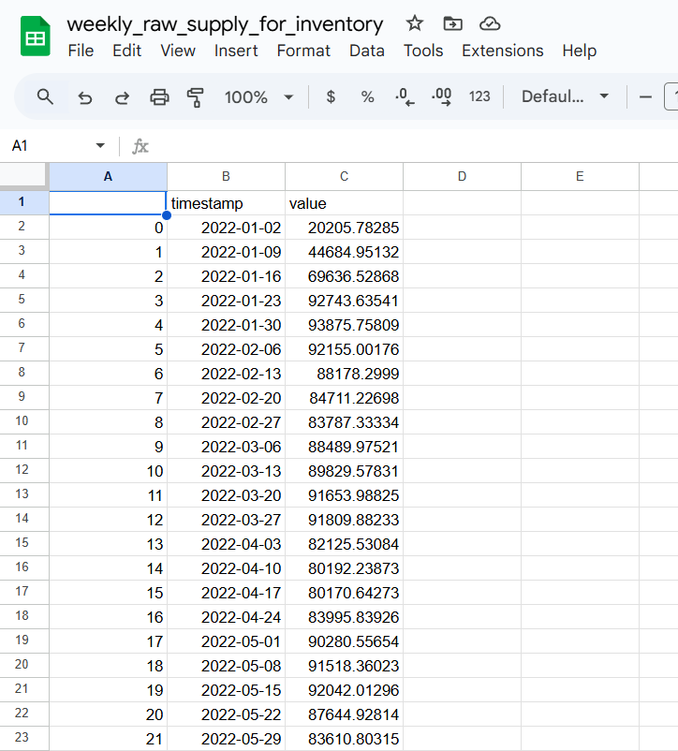
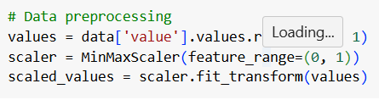
Methodology Evidence of Completion
Data Collection
Data preprocessing
IT21106910 | Gimhani K.M.B.K | 24-25J-303

Slide 33
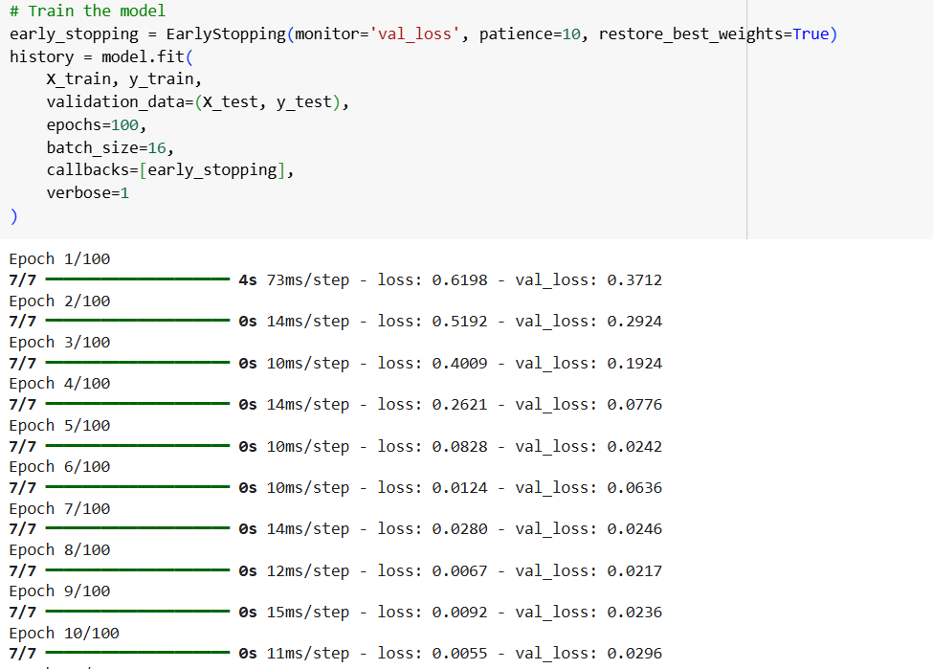
Methodology Evidence of Completion
Training models using preprocessed datasets
IT21106910 | Gimhani K.M.B.K | 24-25J-303

Slide 34
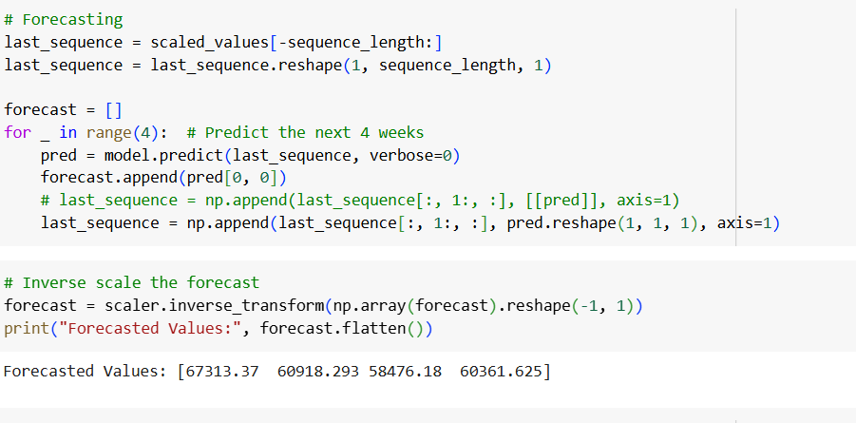
Methodology Evidence of Completion
Weekly Forecasting(Raw Materials) for Next 6 Week
IT21106910 | Gimhani K.M.B.K | 24-25J-303

Slide 35
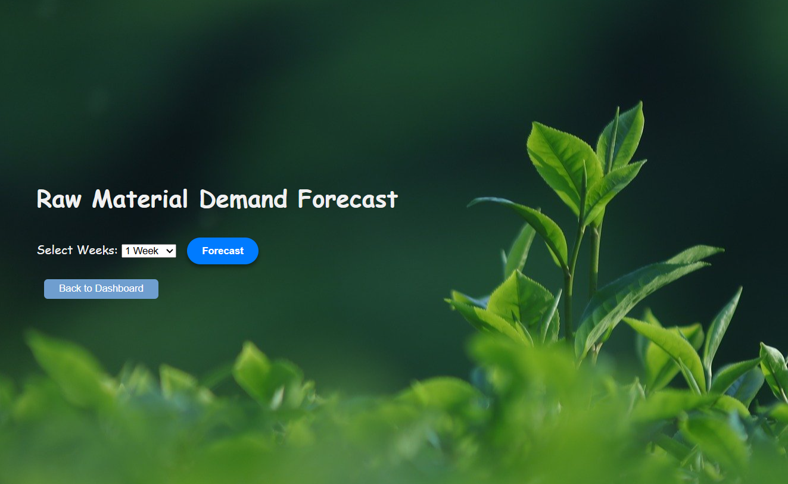
Methodology Evidence of Completion
IT21106910 | Gimhani K.M.B.K | 24-25J-303

Slide 36
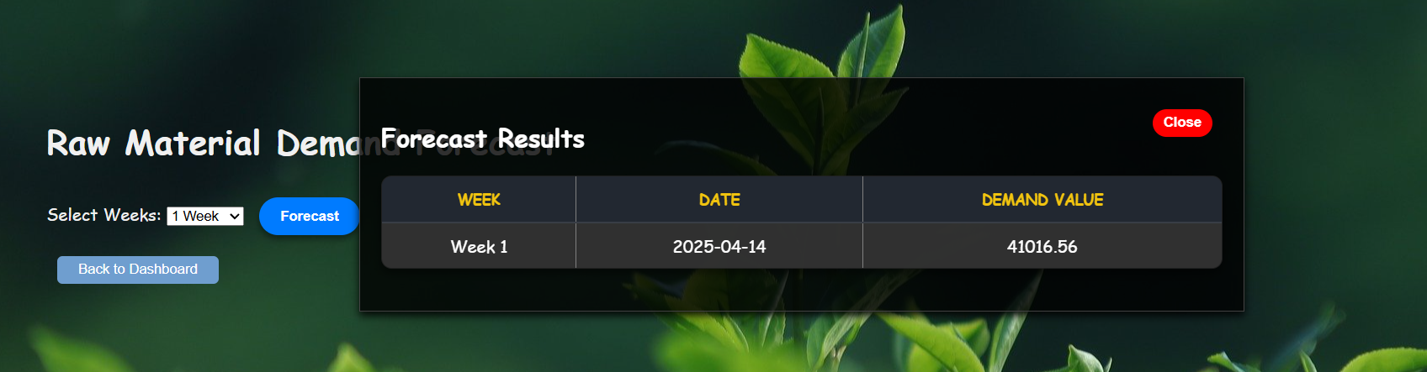
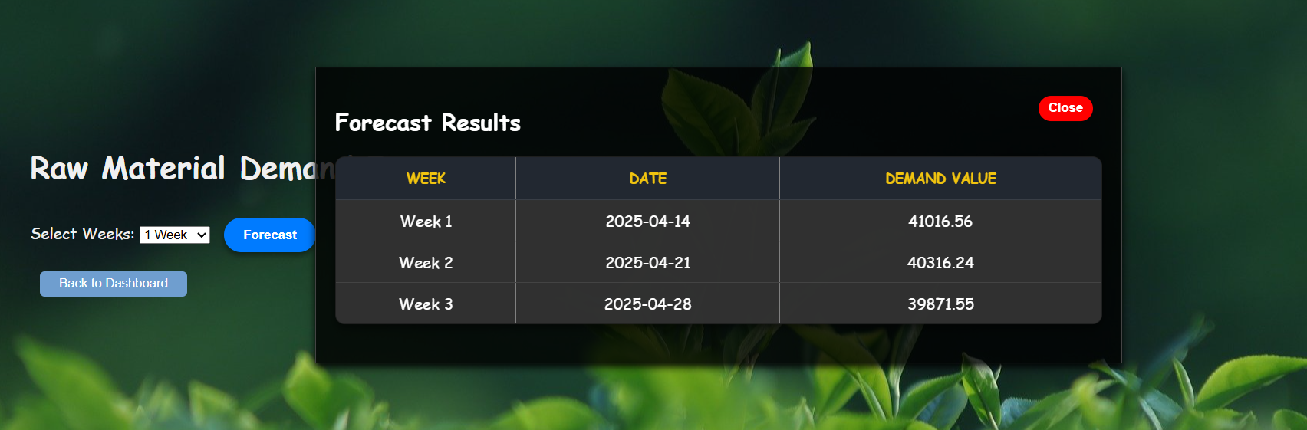
Methodology Evidence of Completion
IT21106910 | Gimhani K.M.B.K | 24-25J-303

Slide 37
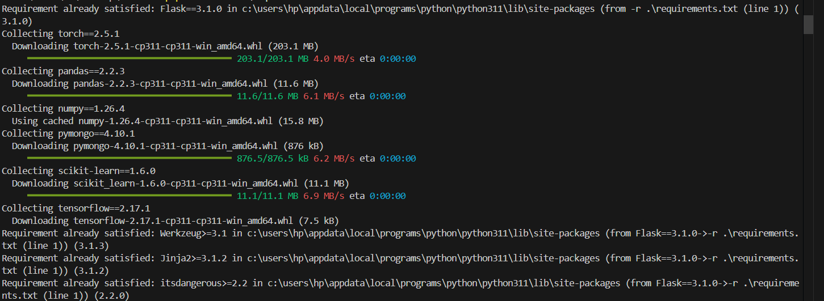
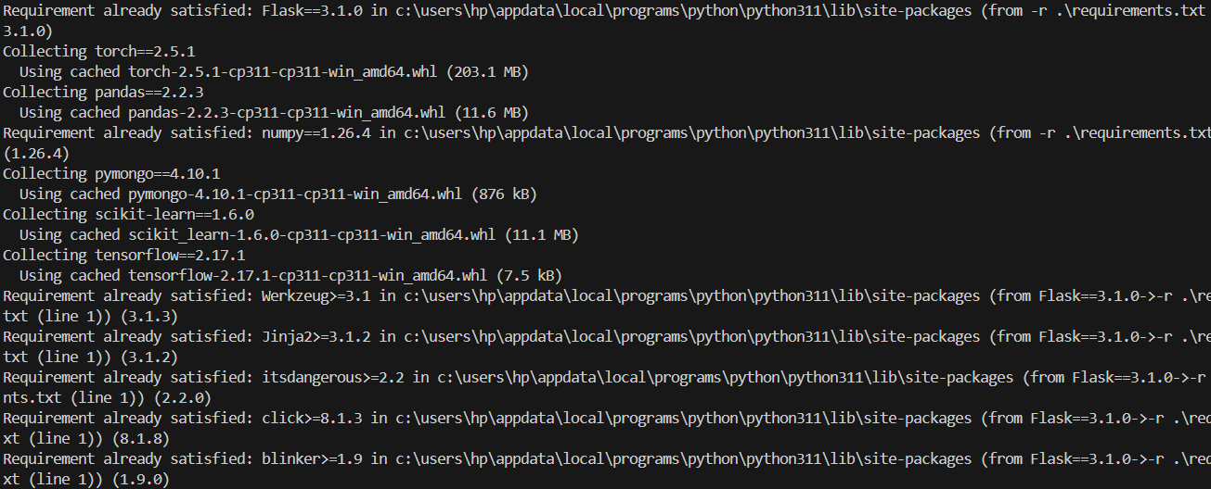
Methodology Evidence of Completion
Deployment in VS code
IT21106910 | Gimhani K.M.B.K | 24-25J-303

Slide 38



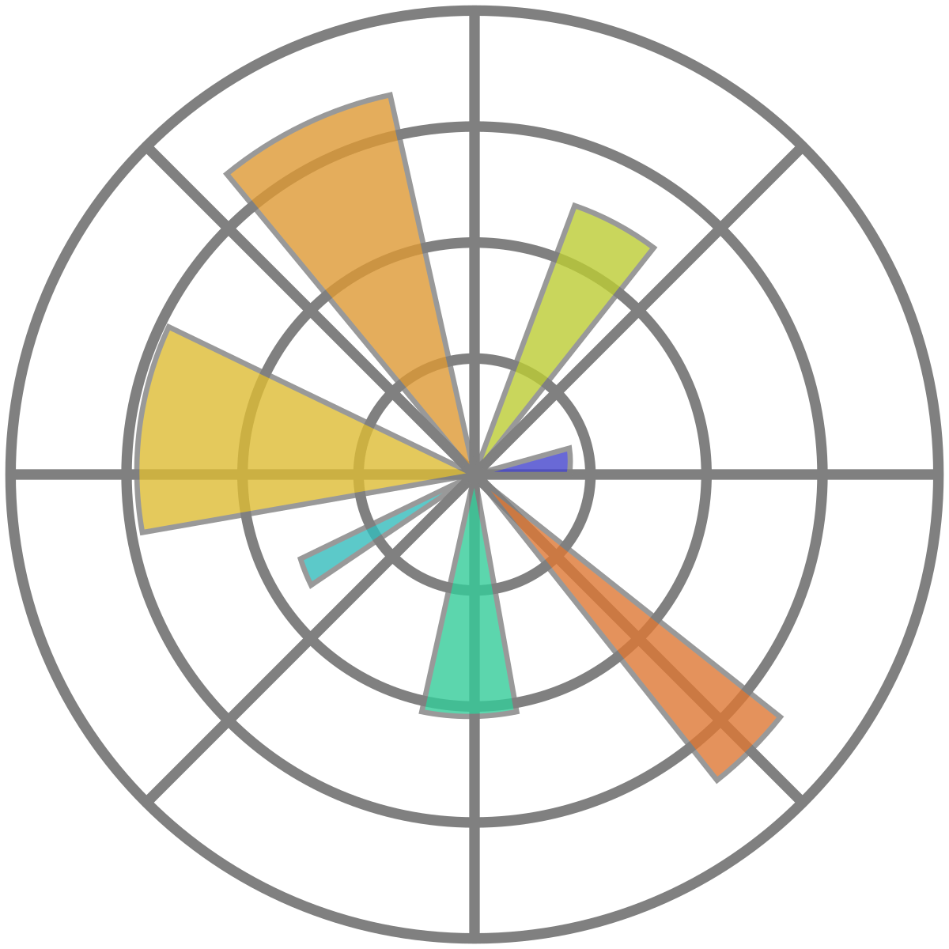

Used Technologies and Techniques
Technologies
Flask Python
TensorFlow
sklearn
numpy
matplotlib
pandas
Model: LSTM
Techniques
Data preprocessing
Data Visualization
IT21106910 | Gimhani K.M.B.K | 24-25J-303

Slide 39
Functional, Non-Functional and Requirements
Functional Requirements
Integrate and preprocess monthly sales forecasts to calculate baseline raw material demand.
Analyze historical data to convert monthly forecasts into weekly requirements.
Validate the system's prediction accuracy using historical and real-time data.
Automate procurement processes based on weekly demand forecasts.
Non-Functional Requirements
Interface should be user-friendly
Application should be reliable
Higher Accuracy of the results
Results should be more efficiency
IT21106910 | Gimhani K.M.B.K | 24-25J-303

Slide 40
References
[1] Zipkin, P. H. (2000). Foundations of Inventory Management. McGraw-Hill.
[2] Silver, E. A., Pyke, D. F., & Thomas, R. (2016). Inventory and Production Management in Supply Chains. 4th Edition. CRC Press.
[3] Snyder, L. V., & Shen, Z. J. M. (2019). Fundamentals of Supply Chain Theory. 2nd Edition. Wiley.
[4] Ivanov, D., Tsipoulanidis, A., & Schönberger, J. (2019). Global Supply Chain and Operations Management: A Decision-Oriented Introduction to the Creation of Value. 2nd Edition. Springer.
[5] Boylan, J. E., & Syntetos, A. A. (2010). "Forecasting for Inventory Management in Supply Chains." International Journal of Forecasting, 26(4), 527–541.
[6] Dekker, R., Kleijn, M., & de Rooij, M. (2013). "An Overview of Inventory Systems with Lateral Transshipments." European Journal of Operational Research, 226(2), 275–282.
[7] Disney, S. M., Towill, D. R., & van de Velde, W. (2004). "Variance Amplification and the Bullwhip Effect in a Class of Supply Chain Forecasting Models." International Journal of Production Economics, 90(3), 311–322.
[8] Fisher, M. L. (1997). "What Is the Right Supply Chain for Your Product?" Harvard Business Review, 75(2), 105–116.
[9] Feng, Q., & Shanthikumar, J. G. (2018). "How Research in Production and Inventory Management Influences Operations Management Practice." Manufacturing & Service Operations Management, 20(3), 453–462.
[10] Chopra, S., & Meindl, P. (2021). Supply Chain Management: Strategy, Planning, and Operation. 8th Edition. Pearson.
IT21106910 | Gimhani K.M.B.K | 24-25J-303

Slide 41

IT21306990 | Wadigasinghe U.K
Specialization : Information Technology
IT21306990 | Wadigasinghe U.K | 24-25J-303

Slide 42
Introduction & Background
Optimizing delivery schedules by forecasting weekly traffic conditions to reduce delays and costs.
Sri Lanka's tea industry faces significant logistical challenges, including traffic-related disruptions.
Inefficient supply chain operations increase transportation expenses and affect delivery timelines.
Predictive analytics and historical traffic data enable smarter scheduling and improved efficiency.
IT21306990 | Wadigasinghe U.K | 24-25J-303

Slide 43


Research Question
How can predictive analytics and historical traffic data be utilized to optimize delivery schedules, minimize transportation delays, and enhance the efficiency of the Tea Factory's supply chain operations?
IT21306990 | Wadigasinghe U.K | 24-25J-303

Slide 44
Research Gap
Limited Consideration of Dynamic Traffic Conditions
Lack of Multi-Modal Transportation Analysis
Absence of Cost Optimization Strategies
Scalability Challenges for Large-Scale Distribution
Uncertainty in Demand-Driven Logistics Planning
IT21306990 | Wadigasinghe U.K | 24-25J-303

Slide 45

Methodology
Data Collection & Analysis
Gather historical traffic data and analyze patterns, including factors like weather and events affecting traffic.
Model Development & Integration
Develop predictive models using machine learning and integrate them into a delivery scheduling system.
Testing & Validation
Compare model forecasts with actual traffic and evaluate the system's impact on delivery efficiency.
Deployment & Monitoring
Deploy the system in logistics operations and refine it continuously based on real-world feedback.
IT21306990 | Wadigasinghe U.K | 24-25J-303

Slide 46
System Diagram
IT21306990 | Wadigasinghe U.K | 24-25J-303

Slide 47
Objective
Sub Objectives
Collect and analyze historical traffic data during critical delivery windows.
Use predictive analytics to forecast traffic conditions for upcoming weeks.
Adjust delivery schedules based on traffic predictions to improve timing and minimize costs.
Optimize logistics efficiency and reduce transportation costs for delivering tea to desired locations.
IT21306990 | Wadigasinghe U.K | 24-25J-303

Slide 48
Functional requirements
Non-Functional requirements
Collect and process historical traffic data from reliable sources.
Generate accurate traffic predictions for upcoming weeks using predictive models.
Provide optimized delivery schedules based on traffic forecasts.
User interface for the transportation manager to manage vehicles, routes, and best delivery times.
Ensure high accuracy and reliability of traffic predictions.
Provide a responsive and user-friendly interface for the transportation manager.
Ensure system scalability to handle increased data and additional logistics routes.
Maintain data security and confidentiality throughout the system.
IT21306990 | Wadigasinghe U.K | 24-25J-303

Slide 49
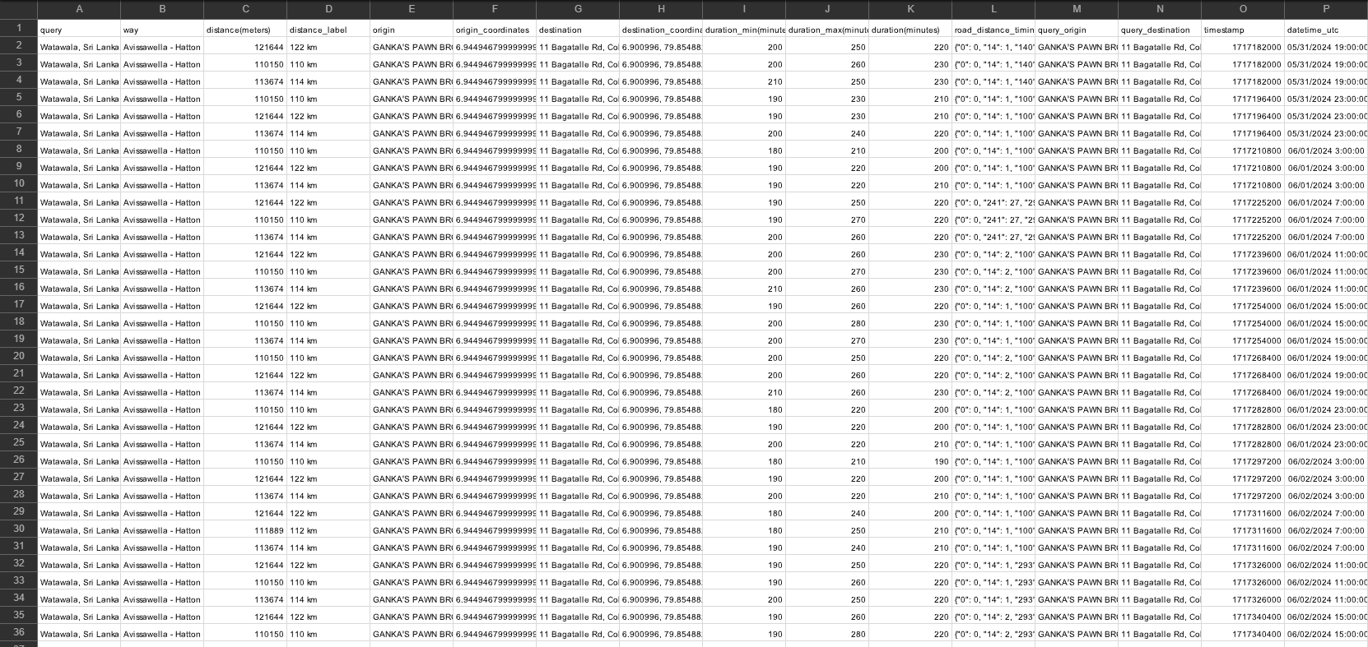
Evidence for Completion
Sub-objective 01
Collect historical traffic data using API
From Watavala to
Colombo
Kaluthara
Gampaha(Nittambuwa)
IT21306990 | Wadigasinghe U.K | 24-25J-303

Slide 50
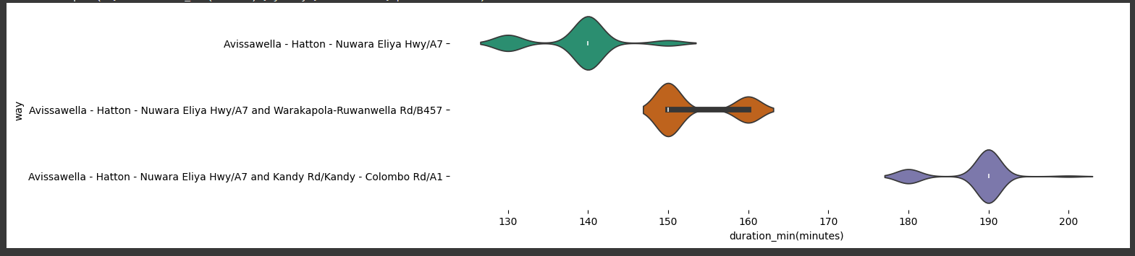
Evidence for Completion
Sub-objective 02
Selecting the best route with minimum time duration
IT21306990 | Wadigasinghe U.K | 24-25J-303

Slide 51
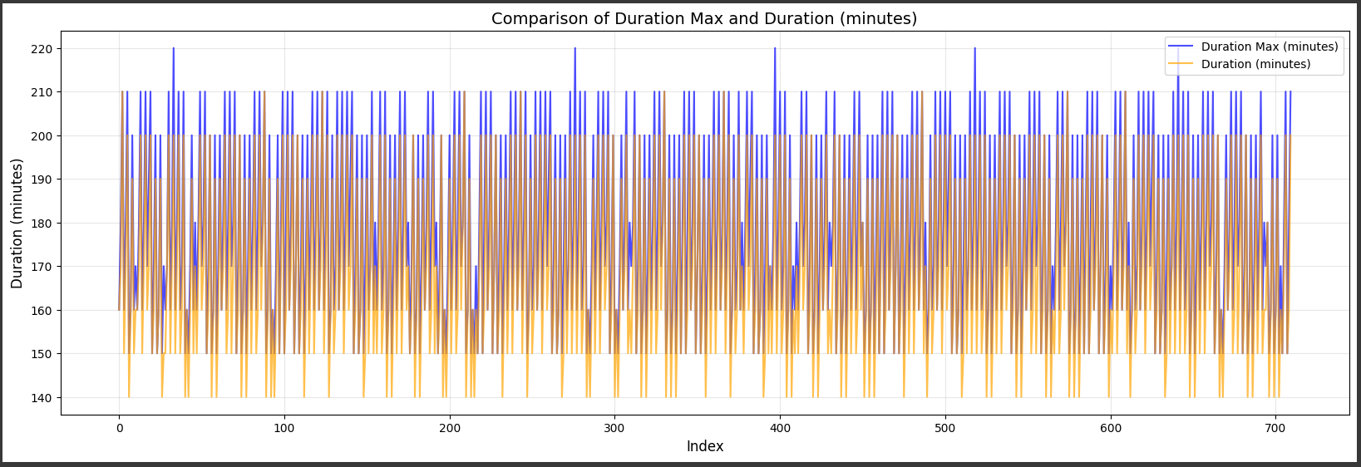
Evidence for Completion
Sub-objective 02
Comparison between Min and Max durations of selected area
IT21306990 | Wadigasinghe U.K | 24-25J-303

Slide 52
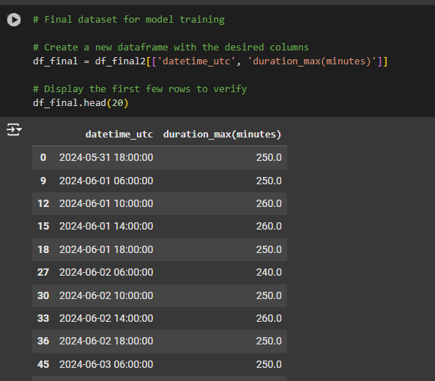
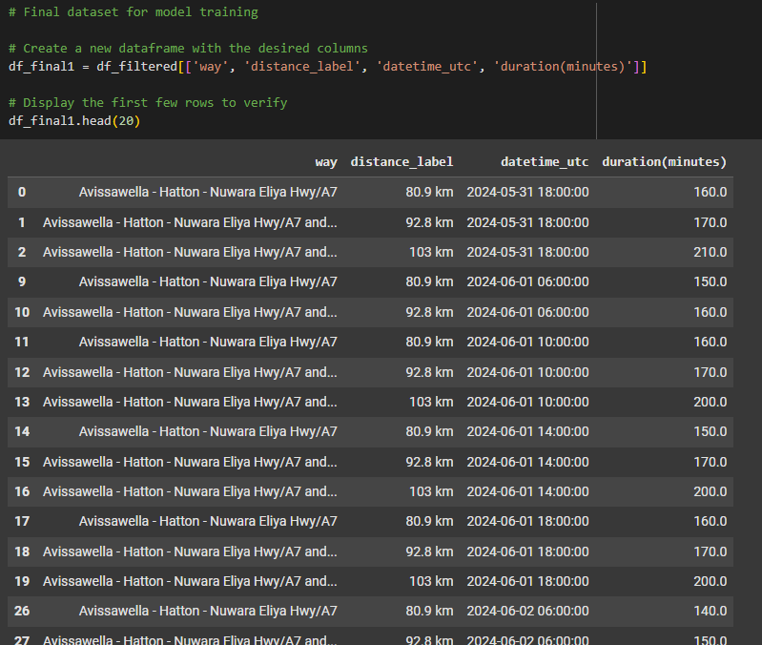
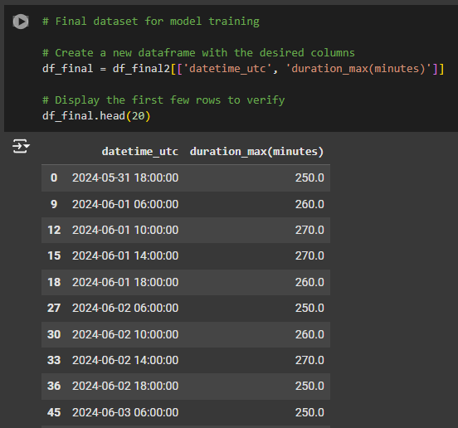
Evidence for Completion
Sub-objective 02
Create final dataset for Model training
Colombo
Nittambuwa
Kaluthara
IT21306990 | Wadigasinghe U.K | 24-25J-303

Slide 53
LSTM Model for Traffic Prediction
Sub-objective 02
What is LSTM?
A type of Recurrent Neural Network (RNN) designed for sequential data like traffic patterns.
Addresses the vanishing gradient problem, enabling learning over extended time periods.
Key Features and Benefits:
Retains past data and long-term dependencies to analyze traffic trends.
Manages time-series data effectively, learning patterns like peak hours, holidays, and seasonal variations.
Models complex, non-linear factors such as weather and events while being resilient to noisy or anomalous data.
IT21306990 | Wadigasinghe U.K | 24-25J-303

Slide 54
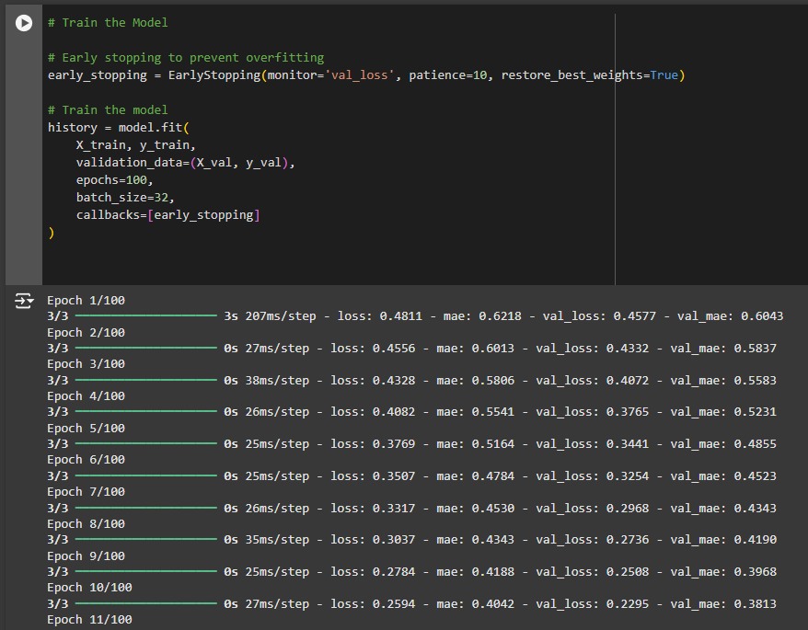
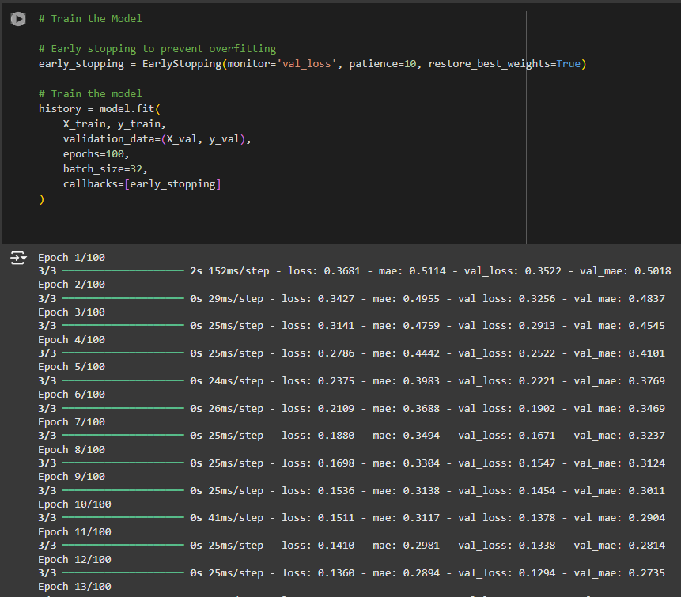
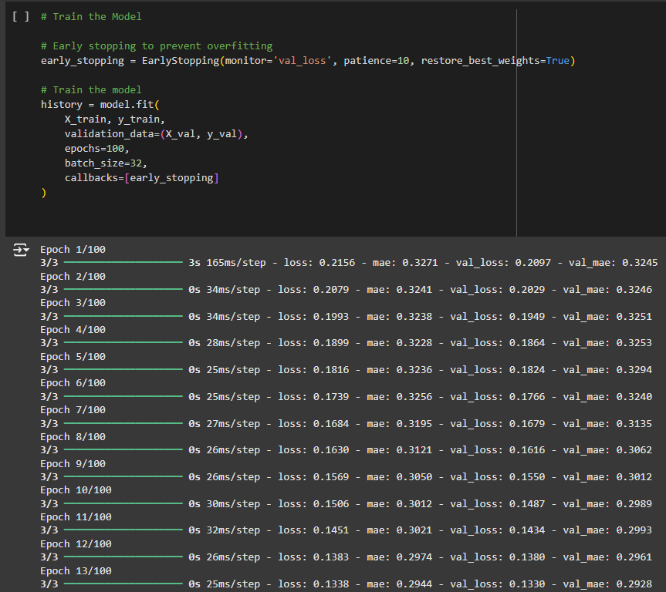
Evidence for Completion
Sub-objective 02
Train each three models using preprocessed datasets
Colombo
Nittambuwa
Kaluthara
IT21306990 | Wadigasinghe U.K | 24-25J-303

Slide 55
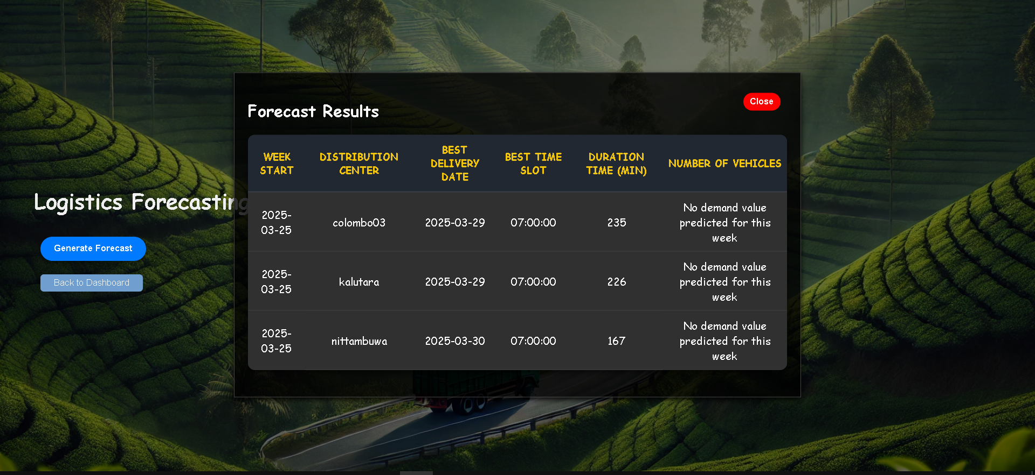
Methodology Evidence of Completion
IT21306990 | Wadigasinghe U.K | 24-25J-303

Slide 56
Used Techniques and Technologies
Technologies
Flask Python
TensorFlow
Flask Server
Google Colab
Matplotlib
Pandas
Sklearn
Techniques
Data preprocessing
Data Visualization
IT21306990 | Wadigasinghe U.K | 24-25J-303

Slide 57
References
Kechagias, Evripidis P., et al. "Traffic flow forecasting for city logistics: A literature review and evaluation." International Journal of Decision Support Systems 4.2 (2019): 159-176.
Chen, Yi-Ting, et al. "Pragmatic real-time logistics management with traffic IoT infrastructure: Big data predictive analytics of freight travel time for Logistics 4.0." International Journal of Production Economics 238 (2021): 108157.
Bhattacharya, Arnab, et al. "An intermodal freight transport system for optimal supply chain logistics." Transportation Research Part C: Emerging Technologies 38 (2014): 73-84.
Gurnak, Vitalii, Lyudmila Volynets, and Ilona Khalatska. "Intellectualization of logistic supply chains on the basis of forecasting volumes of cargo transportation." MATEC Web of Conferences. Vol. 294. EDP Sciences, 2019.
Al Moteri, Moteeb, Surbhi Bhatia Khan, and Mohammed Alojail. "Economic growth forecast model urban supply chain logistics distribution path decision using an improved genetic algorithm." Malaysian Journal of Computer Science (2023): 76-89.
IT21306990 | Wadigasinghe U.K | 24-25J-303

Slide 58

IT21372162 | Bandara D.M.A.T.D
Specialization : Information Technology
IT21372162 | Bandara D.M.A.T.D | 24-25J-303

Slide 59
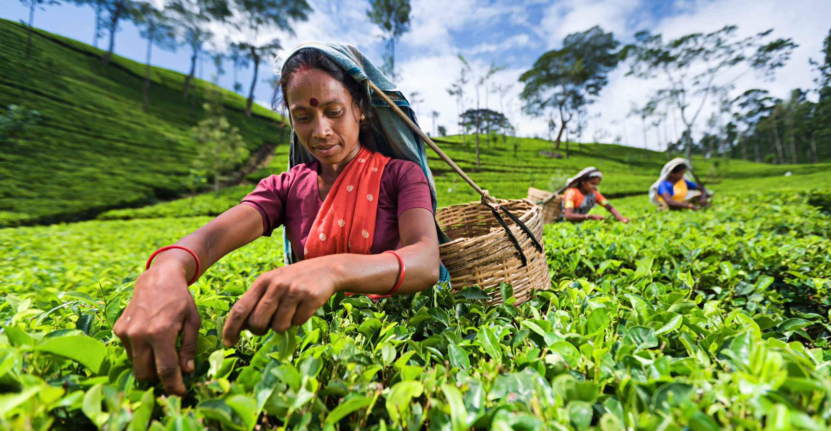




Introduction and Background
Forecast weekly labor needs by area to prevent and manage labor shortages, ensuring smooth operations.
With AI and machine learning, Analyze historical labor data and external factors, develop predictive models, and implement strategies like temporary staffing and production adjustments.
A proactive labor management system that addresses shortages before they impact production.
Complex supply chains, data quality issues, and unpredictable risks make Supply Chain Risk Management a difficult but essential task.
IT21372162 | Bandara D.M.A.T.D | 24-25J-303

Slide 60
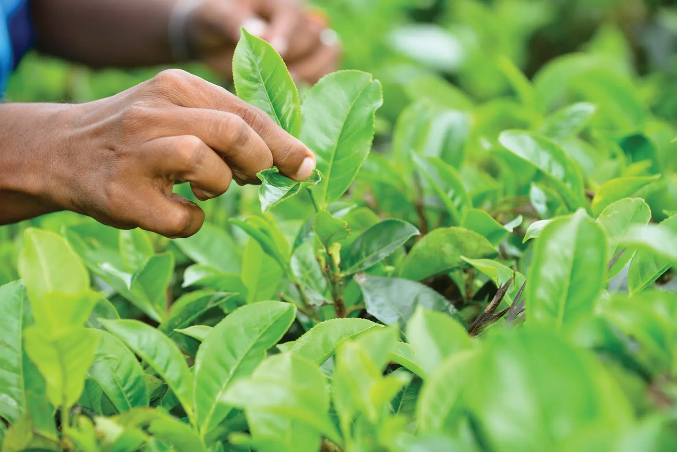
Research Question
How can real-time data help in managing labor shortages and ensuring smooth operations?
Immediate Adjustments
Data-Driven Decisions
Optimization
IT21372162 | Bandara D.M.A.T.D | 24-25J-303

Slide 61

Specific and Sub Objective
Specific Objective
To develop a predictive labor management system that forecasts weekly labor needs by area, using historical data and external factors to mitigate labor shortages and ensure continuous production.
Sub Objective
Data-Driven Labor Forecasting
Labor Allocation Optimization
Real-Time Risk Monitoring
IT21372162 | Bandara D.M.A.T.D | 24-25J-303

Slide 62
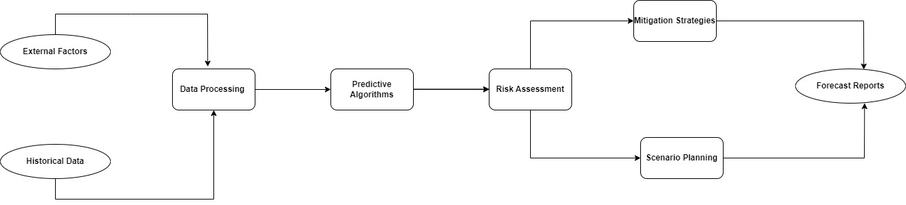
System Diagram
IT21372162 | Bandara D.M.A.T.D | 24-25J-303

Slide 63

Used Technologies and Techniques
Technologies
Flusk framework
HTML/CSS
Firebase
LTSM
Techniques ​
Data preprocessing​
Data Visualization​
IT21372162 | Bandara D.M.A.T.D | 24-25J-303

Slide 64

Methodology
Data Collection and Analysis
Collect historical labor data and external factors (e.g., weather, events) that influence labor availability. Clean and prepare the data for analysis.
Predictive Modeling
Develop forecasting models to predict weekly labour needs by region using historical data and external factors.
Labour Shortage Mitigation Strategies
Create strategies to address labour shortages, such as temporary staffing, flexible schedules, and adjusting production processes.
Real-Time Risk Monitoring and Adjustment
Implement real-time monitoring to track labor availability and adjust plans based on unexpected changes or disruptions.
System Integration and Deployment
Integrate the forecasting and monitoring system with existing tools, and deploy it in stages, ensuring smooth operation and user adoption.
IT21372162 | Bandara D.M.A.T.D | 24-25J-303

Slide 65

Functional, Non-Functional and Requirements
Fuctional Requirements
Non-Functional Requirements
Collect and integrate historical labor data and external factors (e.g., weather, events).
Predict weekly labour requirements by region using predictive models.
Detect potential labor shortages based on forecasted needs.
Suggest mitigation strategies (temporary staffing, flexible scheduling, etc.).
Interface should be intuitive and easy to use.
Application should be reliable with minimal downtime.
Forecasting models should provide accurate labor predictions.
System should process data and deliver predictions efficiently.
IT21372162 | Bandara D.M.A.T.D | 24-25J-303

Slide 66
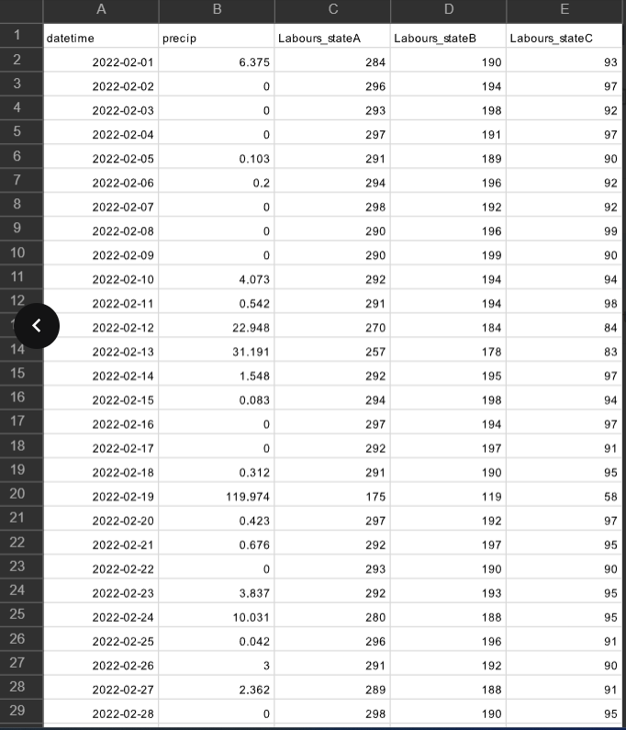
Evidence for Completion
Collect data set labour avalability of monthly
IT21372162 | Bandara D.M.A.T.D | 24-25J-303

Slide 67
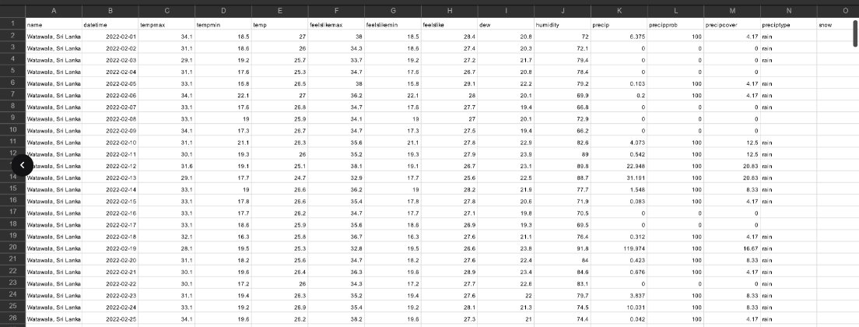
Evidence for Completion ​
Getting monthly weather forecaster data from Watawala area
IT21372162 | Bandara D.M.A.T.D | 24-25J-303

Slide 68
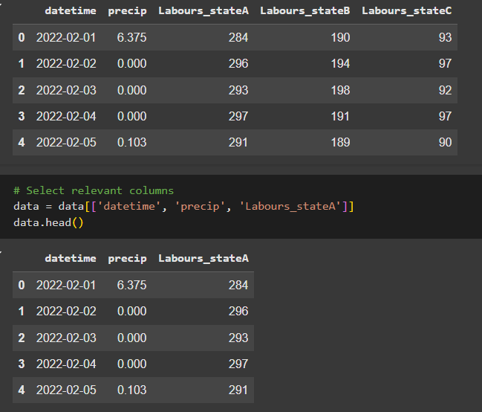
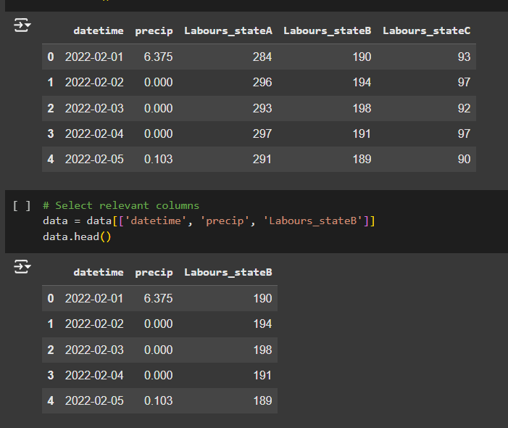
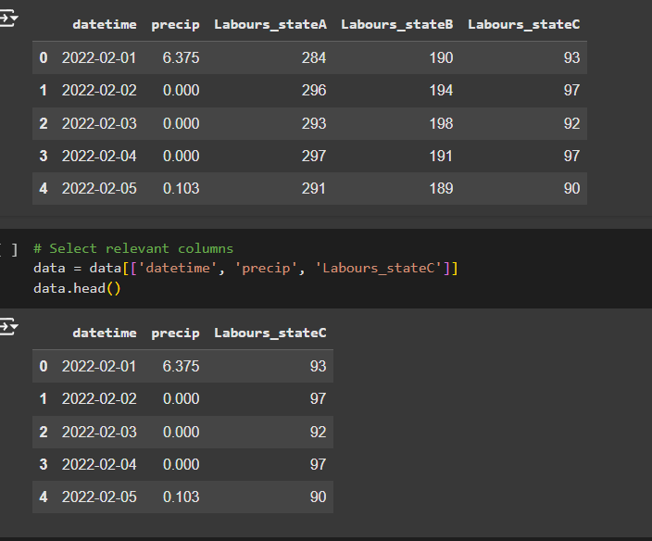
Evidence for Completion
Area A
Area B
Area C
Getting availability labors in each areas
IT21372162 | Bandara D.M.A.T.D | 24-25J-303

Slide 69
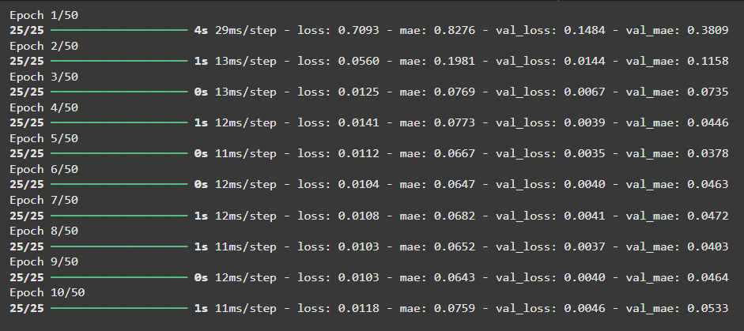
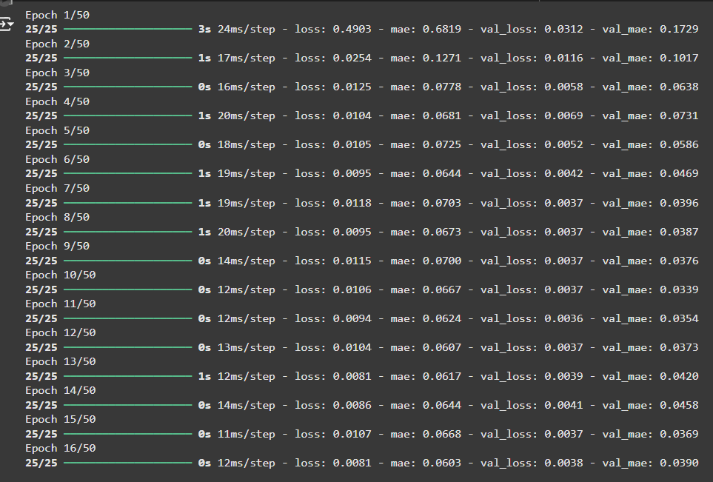
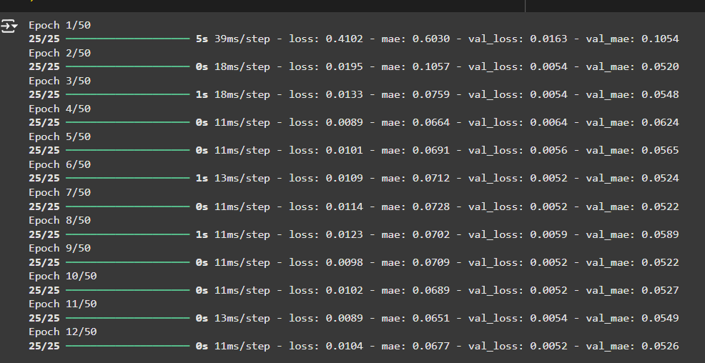
Evidence for Completion
Train each three models using preprocessed datasets
Area A
Area B
Area C
IT21372162 | Bandara D.M.A.T.D | 24-25J-303

Slide 70
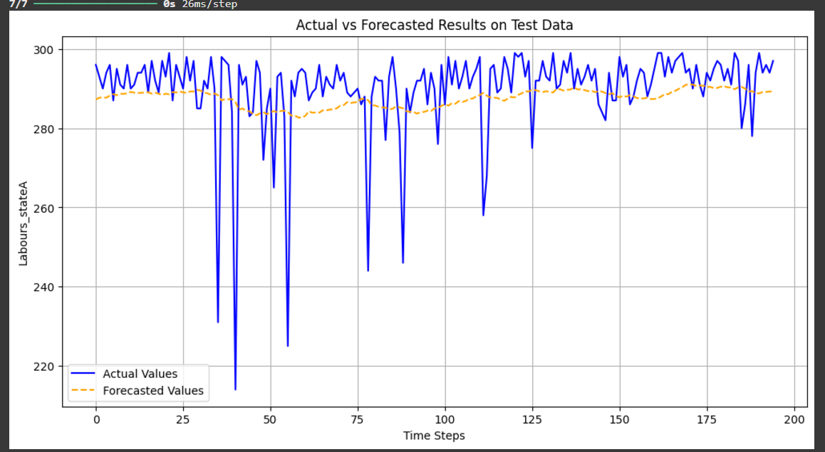
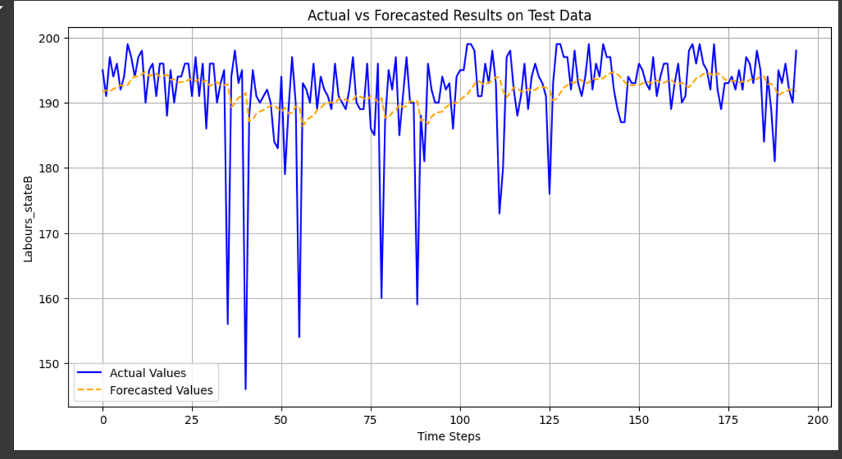
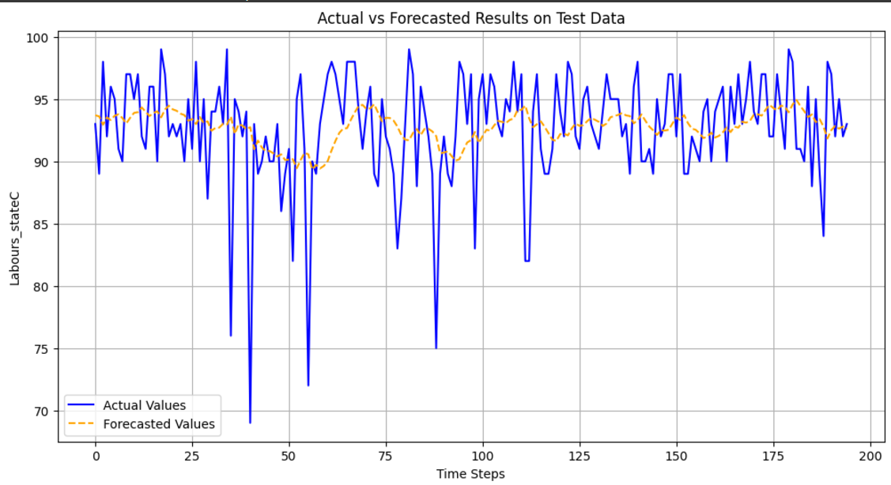
Evidence for Completion
Actual vs forecasted results on test
Area A
Area B
Area C
IT21372162 | Bandara D.M.A.T.D | 24-25J-303

Slide 71
Completion of the project
Collect and analyze labour data and weather data Data preprocessing for train the model.
Train the LSTM model for each selected three areas.
IT21372162 | Bandara D.M.A.T.D | 24-25J-303

Slide 72

Methodology Evidence of Completion
IT21372162 | Bandara D.M.A.T.D | 24-25J-303

Slide 73


Methodology Evidence of Completion
IT21372162 | Bandara D.M.A.T.D | 24-25J-303

Slide 74

Methodology Evidence of Completion
IT21372162 | Bandara D.M.A.T.D | 24-25J-303

Slide 75
Reseach Gap
Lack of Advanced AI Techniques – Existing models do not use LSTM for accurate labor forecasting.
Reliance on Historical Data – Traditional approaches fail to leverage machine learning for dynamic predictions.
No Regional Forecasting – Lack of region-specific labor predictions leads to inefficient workforce distribution.
Static Forecasting Approaches – Most models use historical data alone, without real-time adaptation to changing weather and labor trends.
IT21372162 | Bandara D.M.A.T.D | 24-25J-303

Slide 76

Next Expected Progress
Next Expected Progress
Have to use that trained models and when shortage is not enough in specific area , the other area should be assign labours
Have to create Interfaces and dashboards to the users
Connect with the database
IT21372162 | Bandara D.M.A.T.D | 24-25J-303

Slide 77
References​
[1]ps://journal.oscmforum.org/journal/journal/download/20220415221702_Published_Paper_6_Vol.15_No._2,2022.pdf)
[2]Ivanov, D., & Dolgui, A. (2020). "A digital supply chain twin for managing the disruption risks and resilience in the era of Industry 4.0." Production Planning & Control, 31(2-3), 185-198.
[3]Tang, C. S. (2006). "Perspectives in supply chain risk management." International Journal of Production Economics, 103(2), 451-488.
[4]Kumar, S., & Sharma, A. (2017). "Supply chain risk management: Literature review and future research." Journal of Business & Industrial Marketing, 32(6), 630-642.
[5]Min, H. (2010). "Artificial intelligence in supply chain management: Theory and applications." International Journal of Logistics Research and Applications, 13(1), 13-39.
IT21372162 | Bandara D.M.A.T.D | 24-25J-303

